Slide 1
Cross-Validation in Machine Learning

Slide 2
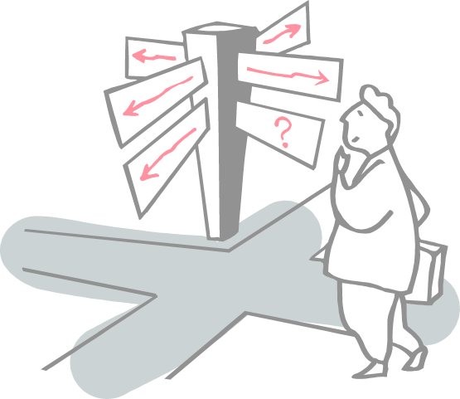
Roadmap
What is Cross-Validation?
Types of Cross-Validation

Slide 3
What is Cross-Validation?
For any model in Machine Learning, it is considered as a best practice if the model is tested with an independent data set.
Normally, any prediction model works on a known data set which is also known as the training set.
But in a real-life scenario, the model will be tested for its efficiency and accuracy with an altogether different and unique data set.
Under those circumstances, you’d want your model to be efficient enough or at least to be at par with the same efficiency that it shows for the training set.
Basically this testing is known as cross-validation in Machine Learning so that it is fit to work with any model in the future.
asserting how the statistical model generalizes to an independent data set

Slide 4
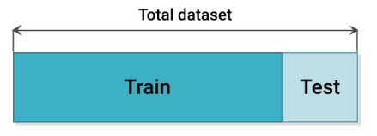
Holdout method
The holdout method is the simplest kind of cross validation.
The data set is separated into two sets, called the training set and the testing set. The function approximator fits a function using the training set only.
Then the function approximator is asked to predict the output values for the data in the testing set (it has never seen these output values before).
The advantage of this method is that it is usually preferable to the residual method and takes no longer to compute.
However, its evaluation can have a high variance.
The evaluation may depend heavily on which data points end up in the training set and which end up in the test set, and thus the evaluation may be significantly different depending on how the division is made.
This lack of training or bias can lead to Underfitting/Overfitting of our model.

Slide 5
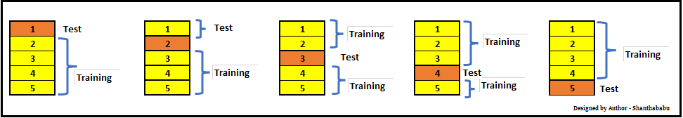
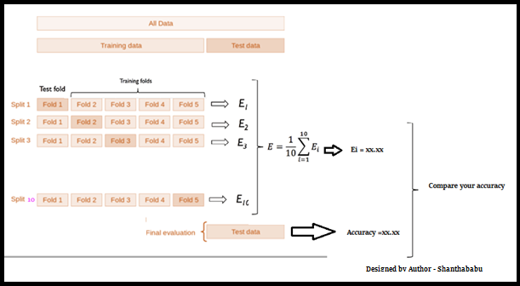
Life Cycle of K-Fold Cross-Validation

Slide 6
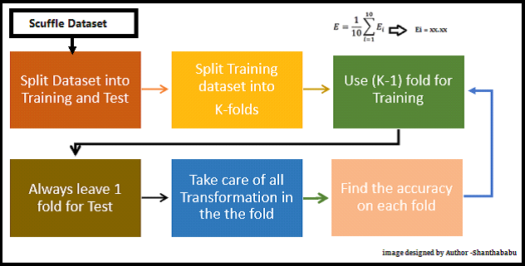
K-Fold Cross-Validation

Slide 7
Stratified K-fold Cross-Validation
In this technique, a slight change is made in the k-fold Cross-Validation. It changes such that each fold will have an approximately equal percentage of samples of each target class as the whole set. In the case of prediction problems, the mean responsive value is approximately equal in all the folds.
In classification problems, the samples may have more negative examples than the positive samples. To tackle this discrepancy we follow the stratified k-fold Cross-Validation technique in Machine Learning

Slide 8
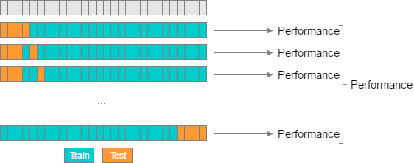
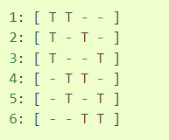
Leave-p-out Cross-Validation (LPOCV)
In this approach, p data points are left out of the training data.
Let’s say there are m data points in the data set, then m-p data points are used for the training phase. And the p data points are kept as the validation set.
This technique is rather exhaustive because the above process is repeated for all the possible combinations in the original data set. To check the overall effectiveness of the model, the error is averaged for all the trials
It becomes computationally infeasible since the model needs to train and validate for all possible combinations and for a considerably large p.

Slide 9
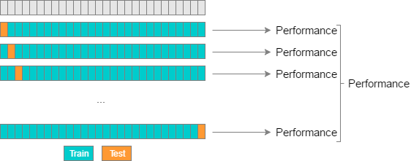
Leave-One-Out Cross Validation(LOOCV)
This method of Cross-validation is similar to Leave-p-out Cross-validation but the only difference is that in this case p = 1. It actually saves a lot of time which is a big advantage.
Although If the sample data is too large, it can still take a lot of time.

Slide 10
Limitations Of Cross-Validation
In an ideal situation, Cross-Validation will produce optimum results. But in case of inconsistent data, the results may vary drastically. It is quite uncertain what kind of data will be encountered by the model.
Predictive modelling often requires an evolution in terms of data, this can pretty much change the training and the validation sets drastically.
The results may vary depending upon the features of the data set.

Slide 11
References
https://medium.com/edureka/cross-validation-in-machine-learning-d629dec3f497
https://machine-learning-tutorial-abi.readthedocs.io/en/latest/content/overview/crossvalidation.html
https://www.cs.cmu.edu/~schneide/tut5/node42.html#:~:text=The%20holdout%20method%20is%20the,using%20the%20training%20set%20only.

Slide 12
Thanks

